Slide 1
Graph Algorithm – Euler Path and Circuits

Slide 2
Introduction
Can we travel along the edges of a graph starting at a vertex and returning to it by traversing each edge of the graph exactly once?
Can we travel along the edges of a graph starting at a vertex and returning to it while visiting each vertex of the graph exactly once
Both questions have many practical applications in many different areas

Slide 3
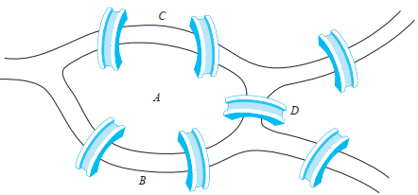
Introduction
The town of Königsberg, Prussia (now called Kaliningrad and part of the Russian republic), was divided into four sections by the branches of the Pregel River.
The townspeople took long walks through town on Sundays.
They wondered whether it was possible to start at some location in the town, travel across all the bridges once without crossing any bridge twice, and return to the starting point.

Slide 4
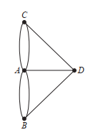
Introduction
The Swiss mathematician Leonhard Euler solved this problem. His solution, published in 1736, may be the first use of graph theory.
Euler studied this problem using the multigraph obtained when the four regions are represented by vertices and the bridges by edge.

Slide 5
EULERIAN PATH - GRAPH
Euler Posed a general problem:
In what type of graph G is it possible to find a closed walk running through every edge of G exactly once?

Slide 6
EULER PATH - GRAPH
Euler Line:
Some closed walk in a graph that contains all the edges of graph, then the walk is called Euler line

Slide 7
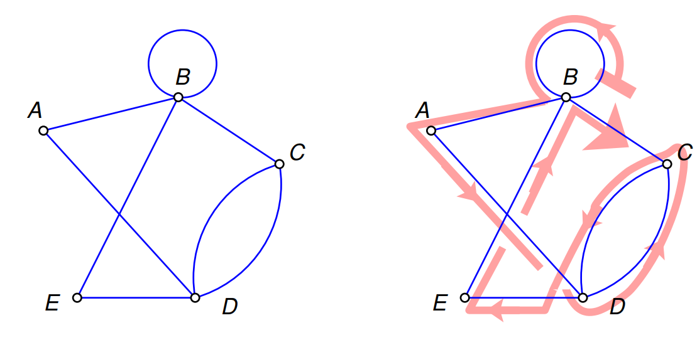
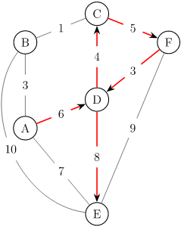
EULER PATH - GRAPH
So now what is a difference between:
Walk
Euler Walk
Walk: ADCFDE

Slide 8
EULER PATH - GRAPH
Euler Path:
“An Euler path in G is a simple path containing every edge of G.”
Euler Circuit:
An Euler circuit in a graph G is a simple circuit containing every edge of G.

Slide 9
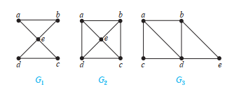
EULER Paths - Circuits
The graph G1 has an Euler circuit, for example, a, e, c, d, e, b, a.
Neither of the graphs G2 or G3 has an Euler circuit.
G3 has an Euler path, namely, a, c, d, e, b, d, a, b. G2 does not have an Euler path

Slide 10
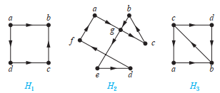
EULER Paths - Circuits
The graph H2 has an Euler circuit, for example, a, g, c, b, g, e, d, f, a.
Neither H1 nor H3 has an Euler circuit.
H3 has an Euler path, c, a, b, c, d, b, but H1 does not

Slide 11
EULER CIRCUIT
A connected multigraph with at least two vertices has an Euler circuit if and only if each of its vertices has even degree
We can now solve the Königsberg bridge problem. Because the multigraph representing these bridges, has four vertices of odd degree, it does not have an Euler circuit.
There is no way to start at a given point, cross each bridge exactly once, and return to the starting point

Slide 12
EULER PATH
A connected multigraph has aa Euler path but not an Euler Circuit if and only if it has exactly two vertices of odd degree.
Returning to Königsberg, is it possible to start at some point in the town, travel across all the bridges, and end up at some other point in town?
Because there are four vertices of odd degree in this multigraph, there is no Euler path, so such a trip is impossible.

Slide 13
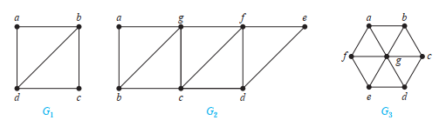
EULER PATH - GRAPH
G1 contains exactly two vertices of odd degree, b and d. It has an Euler path that must have b and d as its endpoints.
G2 contains exactly two vertices of odd degree, b and d. It has an Euler path that must have b and d as its endpoints.
G3 has no Euler path because it has six vertices of odd degree.

Slide 14
EULER PATH - GRAPH
List degree of all vertices
If any degree of vertex is 0, so graph is not connected, so don’t have Euler path, or Euler circuit
If all degree are even, G has Euler path as well as Euler circuit
If exactly 2 vertices are of odd degree than G has Euler path but not Euler circuit

Slide 15
BRIDGE:
“A bridge of a connected graph is a graph edge whose removal disconnects the graph”
Similar, a bridge is an edge removing which increases number of disconnected components.
A bridge is also known as an isthmus, cut-edge, or cut arc.

Slide 16
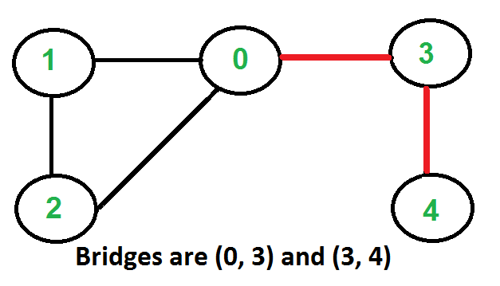
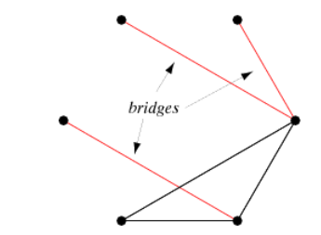
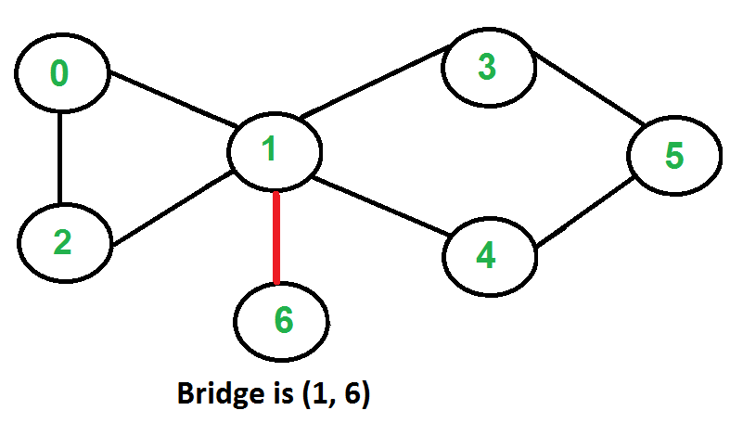
BRIDGE Examples:

Slide 17
FLEURY’S ALGORTIHM
Fleury’s Algorithm is used to display the Euler path or Euler circuit from a given graph.
Starting from one edge, we move other adjacent vertices by removing the previous vertices.
We have to check some rules to get the path or circuit:
The graph must be a Euler Graph.
When there are two edges, one is bridge, another one is non-bridge, we have to choose non-bridge at first.

Slide 18
FLEURY’S ALGORTIHM
Following is Fleury’s Algorithm steps for finding Eulerian trail or cycle:
Make sure the graph has either 0 or 2 vertices with odd degree.
If there are vertex with 0 degree, start anywhere.
If there are 2 vertices with odd degree, start at one of them.
Follow edges one at a time. If you have a choice between a bridge and a non-bridge, always choose the non-bridge.
Stop when you run out of edges.
The idea is, “don’t burn bridges“ so that we can come back to a vertex and traverse remaining edges.

Slide 19
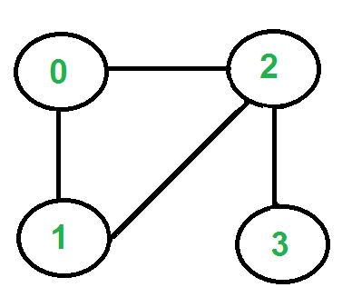
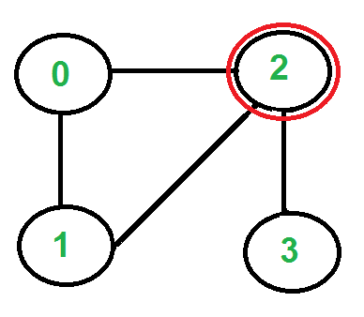
FLEURY’S ALGORTIHM
There are two vertices with odd degree, ‘2’ and ‘3’, we can start path from any of them. Let us start tour from vertex ‘2’.
There are three edges going out from vertex ‘2’, which one to pick?
We don’t pick the edge ‘2-3’ because that is a bridge.
We can pick any of the remaining two edge.
Let us say we pick ‘2-0’. We remove this edge and move to vertex ‘0’.

Slide 20
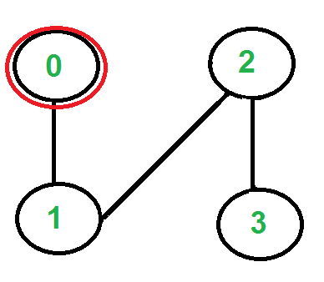
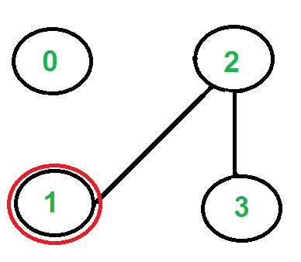
FLEURY’S ALGORTIHM
There is only one edge from vertex ‘0’, so we pick it, remove it and move to vertex ‘1’. Euler tour becomes ‘2-0 0-1’.
There is only one edge from vertex ‘1’, so we pick it, remove it and move to vertex ‘2’. Euler tour becomes ‘2-0 0-1 1-2’

Slide 21
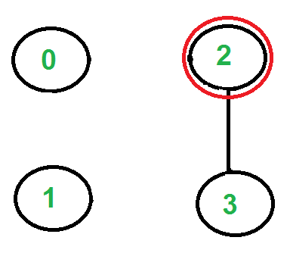
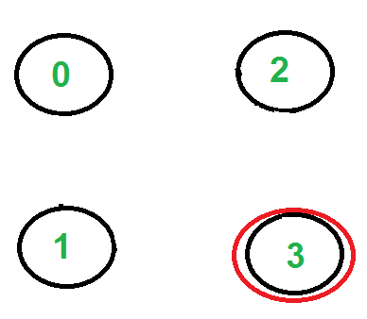
FLEURY’S ALGORTIHM
Again there is only one edge from vertex 2, so we pick it, remove it and move to vertex 3. Euler tour becomes ‘2-0 0-1 1-2 2-3’
There are no more edges left, so we stop here. Final tour is ‘2-0 0-1 1-2 2-3’.

Slide 22
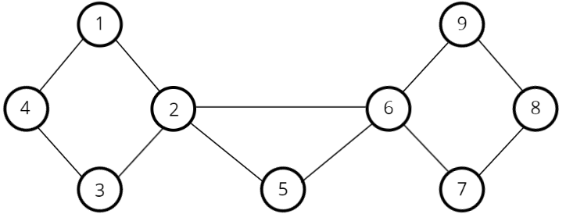
FLEURY’S ALGORTIHM – Example 2

Slide 23
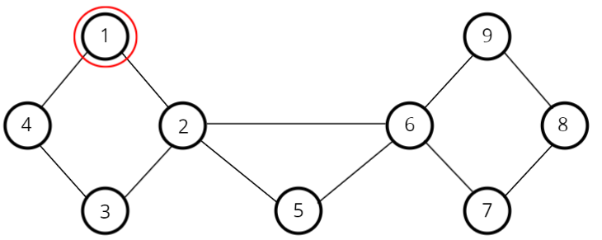
FLEURY’S ALGORTIHM – Example 2

Slide 24
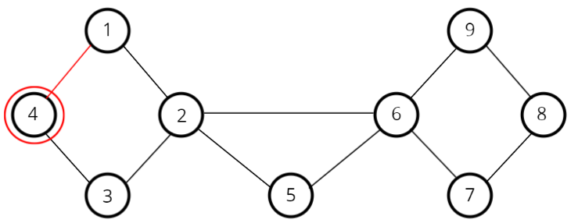
FLEURY’S ALGORTIHM – Example 2

Slide 25
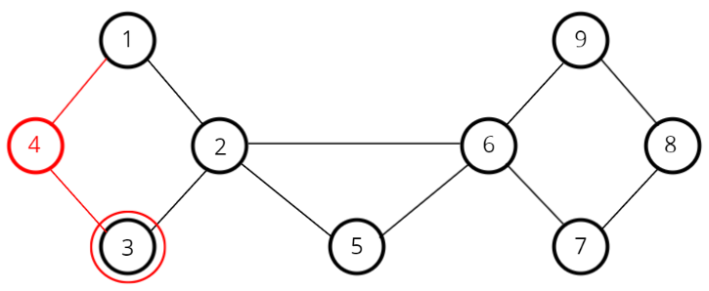
FLEURY’S ALGORTIHM – Example 2

Slide 26
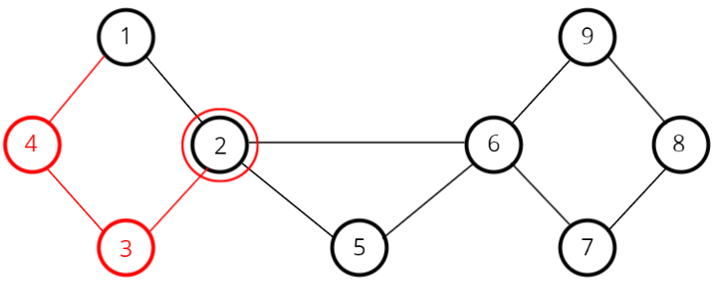
FLEURY’S ALGORTIHM – Example 2

Slide 27
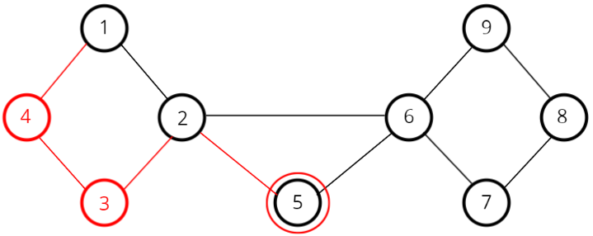
FLEURY’S ALGORTIHM – Example 2

Slide 28
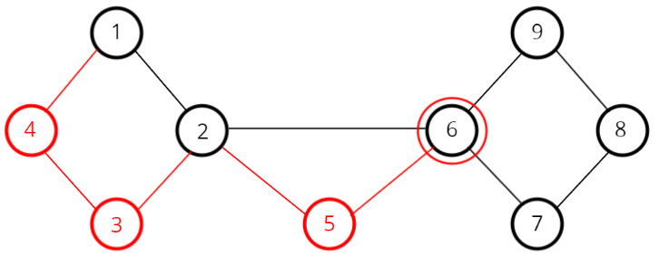
FLEURY’S ALGORTIHM – Example 2

Slide 29
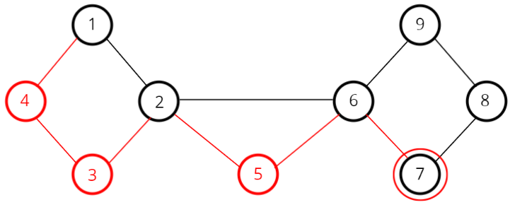
FLEURY’S ALGORTIHM – Example 2

Slide 30
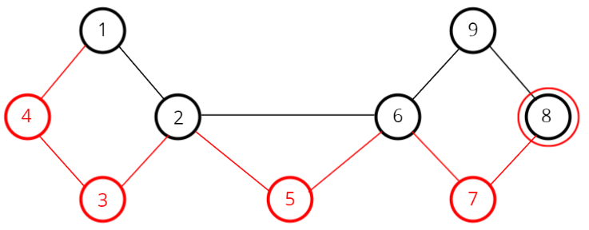
FLEURY’S ALGORTIHM – Example 2

Slide 31
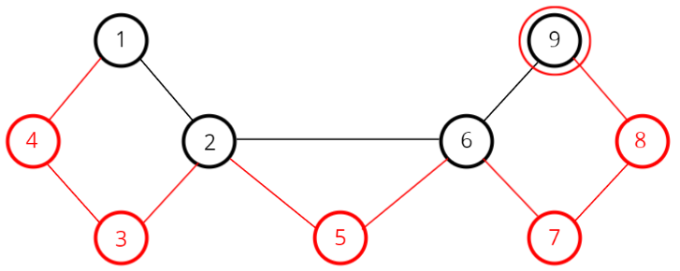
FLEURY’S ALGORTIHM – Example 2

Slide 32
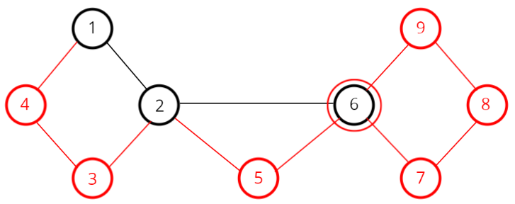
FLEURY’S ALGORTIHM – Example 2

Slide 33
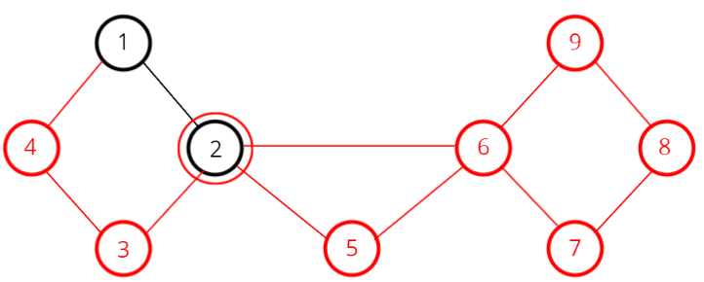
FLEURY’S ALGORTIHM – Example 2

Slide 34
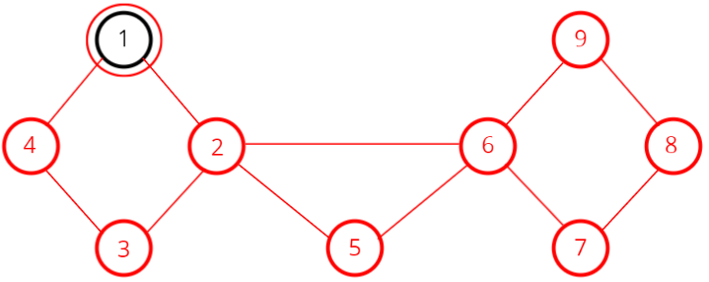
FLEURY’S ALGORTIHM – Example 2

Slide 35
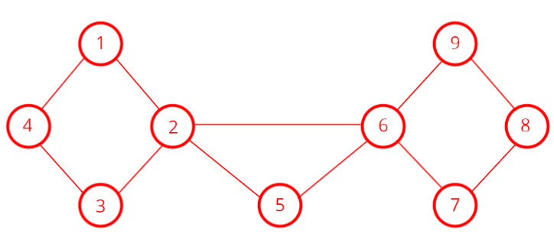
FLEURY’S ALGORTIHM – Example 2

Slide 36
APPLICATION OF EULER PATHS AND CIRCUITS
Euler paths and circuits can be used to solve many practical problems.
Many applications ask for a path or circuit that traverses each street in a neighborhood, each road in a transportation network, each connection in a utility grid, or each link in a communications network exactly once.
If a postman can find an Euler path in the graph that represents the streets the postman needs to cover, this path produces a route that traverses each street of the route exactly once.
Among the other areas where Euler circuits and paths are applied is in the layout of circuits, in network multicasting, and in molecular biology, where Euler paths are used in the sequencing of DNA.

Slide 37
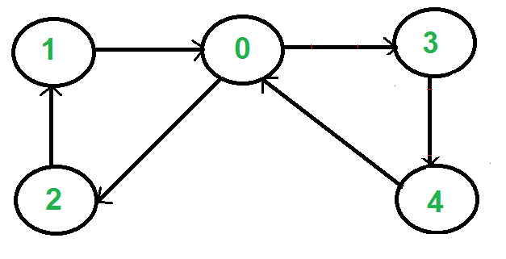
Euler Circuit - Directed Graph
A directed graph has an eulerian cycle if following conditions are true:
All vertices with nonzero degree belong to a single strongly connected component.
In degree is equal to the out degree for every vertex.
A directed graph is strongly connected if there is a path between all pairs of vertices.
Graph has eulerian cycle as {1, 0, 3, 4, 0, 2, 1}

Slide 38
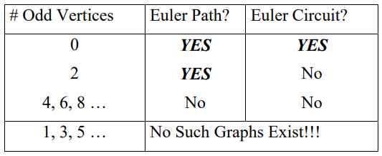
Euler Theorem
Tracing a graph: A graph can be traced if you can begin at an edge and draw the entire graph without lifting up your pencil or going over an edge twice. If a graph contains two odd vertices, you must begin at one and end at the other

Slide 39
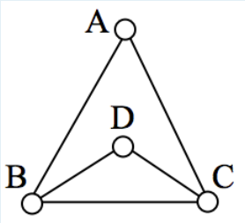
Exercise 1:
For the following Graph (G1):
Calculate the degree of all the vertices.
For graph G, is there exists any Euler paths?
If Euler path exist, write down 1 Euler path?
If Euler path do not exists, why?
For graph G, is there exists Euler circuits?
a. If Euler circuit exists, write down 1 Euler circuit?
b. If no Euler circuit exists, why?
In the graph (G1), there are several Euler paths. One such path is CABDCB.
Euler circuit do not exists because vertex B and C have odd degrees
Notes:
In the graph (G1), there are several Euler paths. One such path is CABDCB.
Euler circuit do not exists because vertex B and C have odd degrees

Slide 40
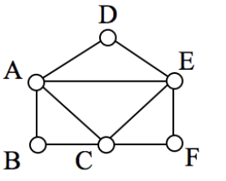
Exercise 2:
For the following Graph (G2):
Calculate the degree of all the vertices.
For graph G, is there exists any Euler paths?
If Euler path exist, write down 1 Euler path?
If Euler path do not exists, why?
For graph G, is there exists Euler circuits?
a. If Euler circuit exists, write down 1 Euler circuit?
b. If no Euler circuit exists, why?
In the graph (G1), there are several Euler paths.
The graph G2 has several possible Euler circuits. Here’s a couple, starting and ending at vertex A: ADEACEFCBA and AECABCFEDA.
Degree of all the vertices is even.
Notes:
In the graph (G1), there are several Euler paths.
The graph G2 has several possible Euler circuits. Here’s a couple, starting and ending at vertex A: ADEACEFCBA and AECABCFEDA.
Degree of all the vertices is even

Slide 41
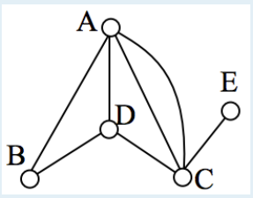
Exercise 3:
For the following Graph (G3):
Calculate the degree of all the vertices.
For graph G, is there exists any Euler paths?
If Euler path exist, write down 1 Euler path?
If Euler path do not exists, why?
For graph G, is there exists Euler circuits?
a. If Euler circuit exists, write down 1 Euler circuit?
b. If no Euler circuit exists, why?
In the graph G3, vertices A and C have degree 4, since there are 4 edges leading into each vertex. B is degree 2, D is degree 3, and E is degree 1.
This graph contains two vertices with odd degree (D and E) and three vertices with even degree (A, B, and C),
so Euler’s theorems tell us this graph has an Euler path, but not an Euler circuit.
Notes:
In the graph G3, vertices A and C have degree 4, since there are 4 edges leading into each vertex. B is degree 2, D is degree 3, and E is degree 1.
This graph contains two vertices with odd degree (D and E) and three vertices with even degree (A, B, and C),
so Euler’s theorems tell us this graph has an Euler path, but not an Euler circuit.

Slide 42
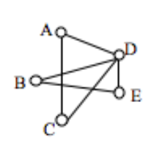
Exercise 4:
For the following Graph (G4):
Calculate the degree of all the vertices?
Is Euler path(s) exists for graph G4?
Is Euler circuit(s) exists for graph G4?
Is there exists a bridge(s) in the graph?
If yes, identify and write down the bridge(s) edge?
Apply Fleury’s Algorithm to find Euler Circuit (if exists), otherwise find Euler Path
Find an Euler Circuit on this graph using Fleury’s algorithm, starting at vertex A.
Notes:
Find an Euler Circuit on this graph using Fleury’s algorithm, starting at vertex A.

Slide 43
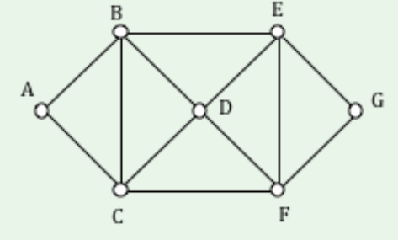
Exercise 5:
For the following Graph (G5):
Calculate degree of all vertices
Identify bridge (if any exists)
Apply Fleury’s Algorithm to find Euler Circuit

Slide 44
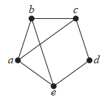
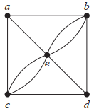
Exercises – Euler Graphs

